Slide 1

WorkWise
ADAPTIVE WORK MANAGEMENT APPLICATION FOR ELEVATED PRODUCTIVITY
PAVITHRA S
2022MT93172

Slide 2
COntents
Introduction
Application architecture
Component Diagram
What is GenAI?
Gemini Integration
Design Specifications
Goal Management
Task Management
Dashboard
Application Demo
Conclusion

Slide 3
INTRODUCTION
The "Adaptive Work Management Application for Elevated Productivity" system, Workwise, aims to help working professionals with task management and goal setting by leveraging GenAI technology.
Gemini, the chosen GenAI model, is seamlessly integrated into the core functionality of the application.
By harnessing Gemini's capabilities, the application provides personalized recommendations to the users.
It ensures that tasks are prioritized effectively, and goals are set in alignment with the SMART criteria.

Slide 4
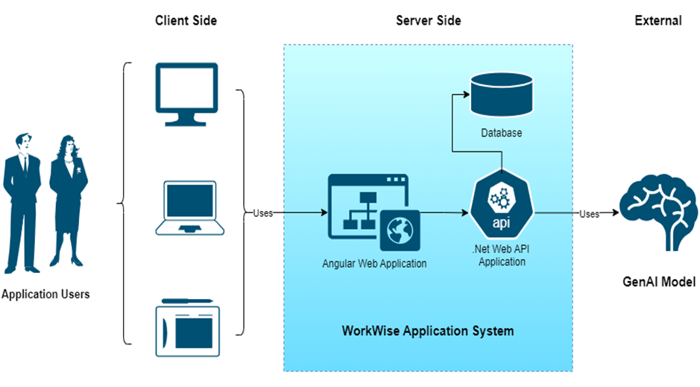
APPLICATION ARCHITECTURE

Slide 5
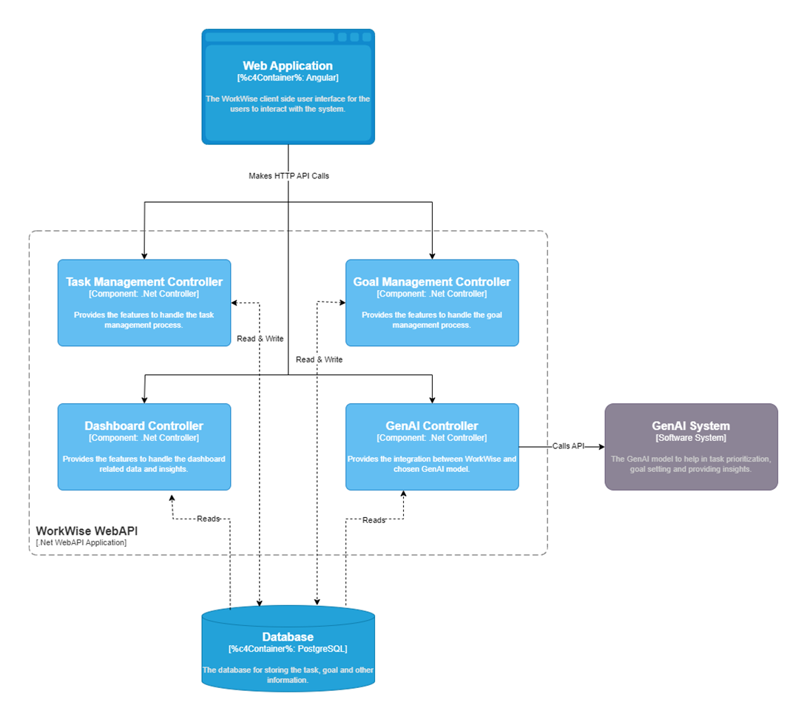
Component diagram
The Component Diagram elaborates on the containers within the WorkWise API application. The four main components: The Task Management Controller, Goal Management Controller, Dashboard Controller, and GenAI Controller. The diagram also shows how the different components interact with each other.

Slide 6
What is GENAI?
Examples: ChatGpt, Gemini etc
GenAI: Short for Generative Artificial Intelligence.
It is a conversational AI model designed to engage in human-like text-based conversations, understand context, generate relevant responses, and provide assistance across a wide range of topics.
GenAI can learn, reason, and solve problems autonomously.
GenAI is adaptable and can perform a wide range of tasks without specific programming though prompts.

Slide 7
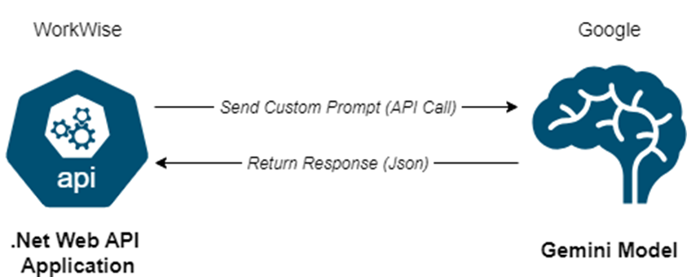
Gemini integration
The GenAI model used in WorkWise is Gemini, provided by Google. This advanced artificial intelligence model is chosen for its growing popularity and accessibility. It offers a free developer version currently, making it an ideal choice for testing and integration into the application.

Slide 8
DESIGN SPECIFICATIONS
User-Centric Design
Security
Maintainability

Slide 9
GOAL MANAGEMENT
In the Goal Management module, users can create and track goals.
They can also easily update and delete the goals if required.
Each goal adheres to the SMART criterial and includes details such as the name, description, priority, start date, due date, status etc.
Additionally, each goal consists of a set of tasks making the goals measurable and track the progress.
The Gemini model assists users in the goal creation process.

Slide 10
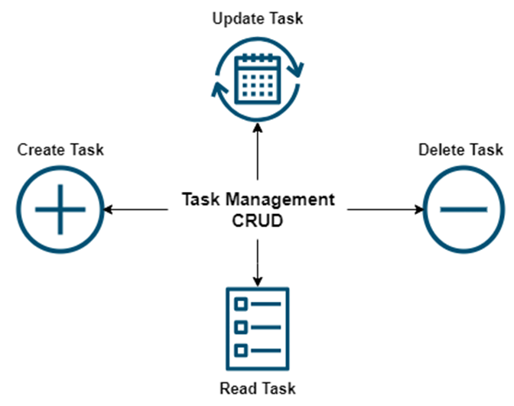
TASK MANAGEMENT
The Task Management module lets users perform various actions like creating, updating, deleting, and viewing individual tasks like maintaining a to do list.
Each task includes details such as Task Name, Task Description, Priority, Start Date, Due Date, Status, etc.

Slide 11
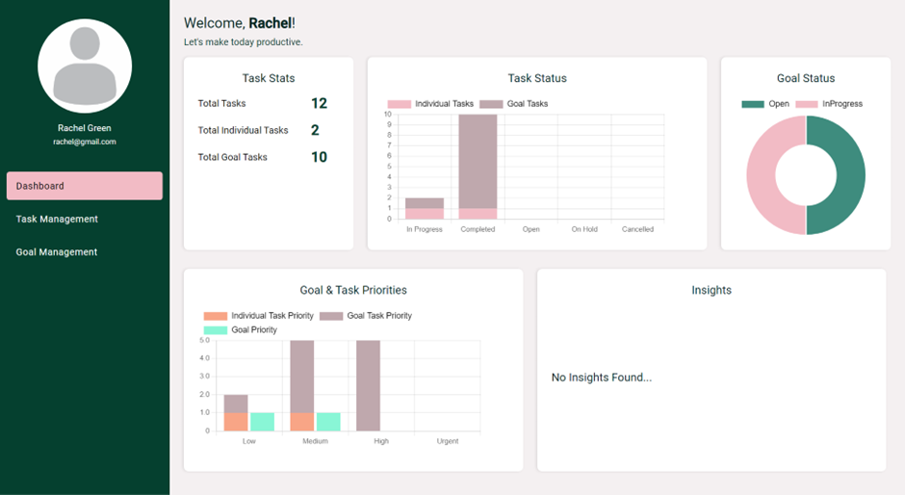
DASHBOARD
The Dashboard Insights module helps users keep track of their tasks and goals in one place, making it easy to see how they're doing.

Slide 12
APPLICATION DEMO

Slide 13
coNCLUSION
In conclusion, the "Adaptive Work Management Application for Elevated Productivity" demonstrates the potential of integrating GenAI technology into existing applications to enhance productivity and goal achievement for working professionals.
Through the implementation of key modules such as goal setting, the application offers a user-friendly solution aimed at facilitating efficient task management.
While GenAI-based intelligence offers significant potential, there may be instances where it provides inaccurate or unreliable information, particularly during its developmental stages.

Slide 14
THANK YOU
Pavithra S
2022MT93172
2022mt93172@wilp.bits-pilani.ac.in

